Slide 1

June 15, 2010
David Natsheh
Product Manager Inmarsat Maritime

Slide 2
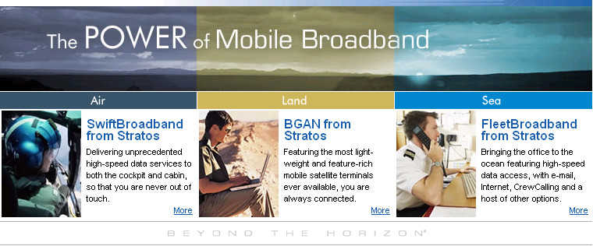
Mobile Broadband Satellite Services
www.thePowerOfMobileBroadband.com

Slide 3
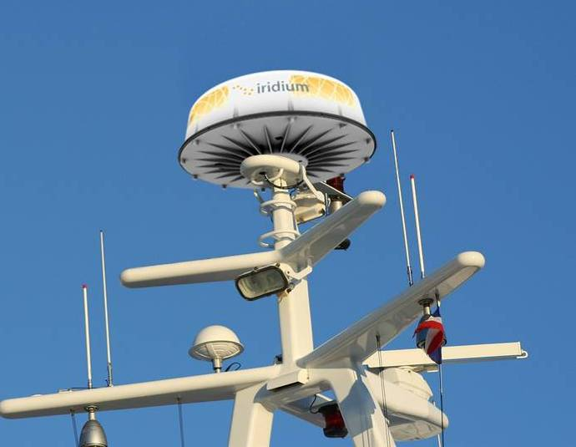
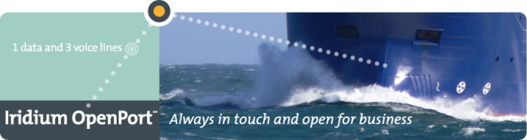
Iridium OpenPort
Iridium’s new IP data and Voice Service for the Maritime Market launched late 2008
Fully supported by the Stratos Advantage™

Slide 4





Agenda
Introduction
Background on FleetBroadband
  Service Description
The Stratos Advantage™
  Equipment
  Flexible Pricing Plans
  Network Infrastructure
  Management of Services
  Optimizing your link
  Consultancy

Slide 5

FleetBroadband, the service and the network

Slide 6




FleetBroadband Gives You:
4kbps circuit-switched service
Voicemail
Enhanced services: call waiting, forwarding, barring, holding
Broadcast quality voice
Voice
+
Standard IP (NOT MPDS)
Variable bit rate service – Shared & Best Effort
Up to 432/432 kbps (send /receive)
Data –
Std IP
+
On-demand Guaranteed bit rate service
8,16,32, 64, 128, 256 kbps (send & receive)
ISDN – Legacy compatibility.
Data - Streaming
+
Text
Send and receive text messages via your laptop
…Simultaneously
…On-Demand Choice of Services
…Easy, Quick & Painless installation
…Easy to Operate and Proven Technology

Slide 7
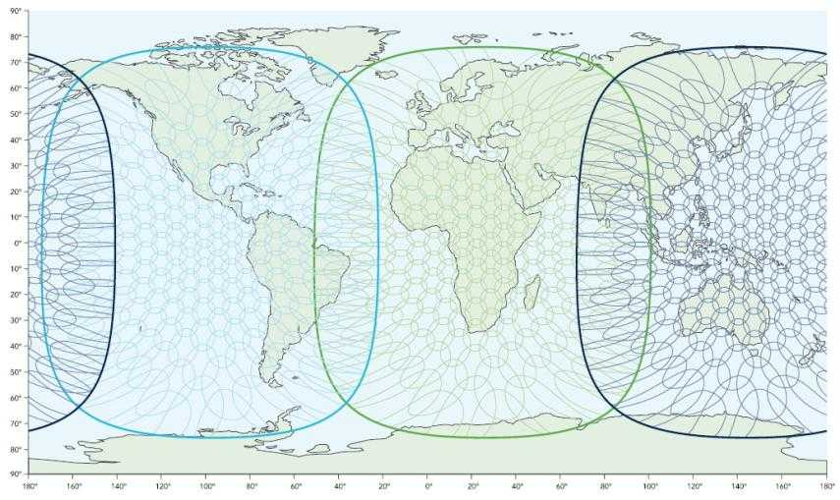

FleetBroadband Worldwide Coverage Map

Slide 8
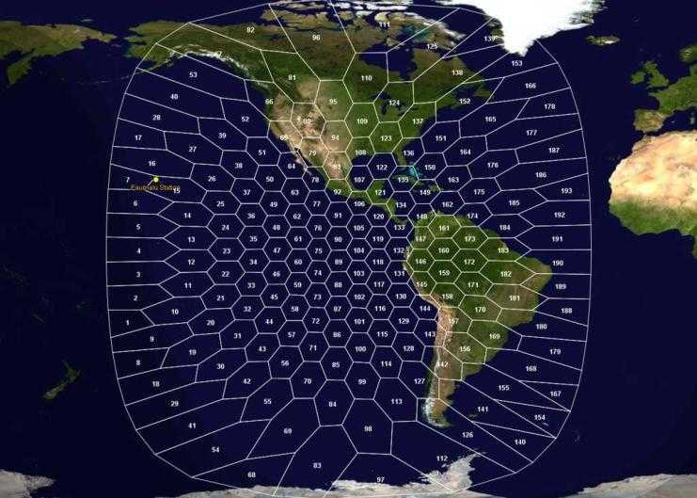
FleetBroadband Narrow (Spot) Beam Map I-4 Americas

Slide 9

Inmarsat-4 (I-4) Satellites:
The Backbone for FleetBroadband
The Inmarsat-4 (I-4) network of Satellites is the backbone of FleetBroadband
Most advanced network of commercial communications satellites ever launched
$1.5 billion investment
Support latest generation of mobile broadband services
One I-4 satellite is 60 times more powerful than an I-3 satellite
Commercial life into the 2020’s
Part of a total constellation of 11 satellites in geostationary orbit
Courtesy ILS & Lockheed Martin Corporation
Courtesy: ILS

Slide 10
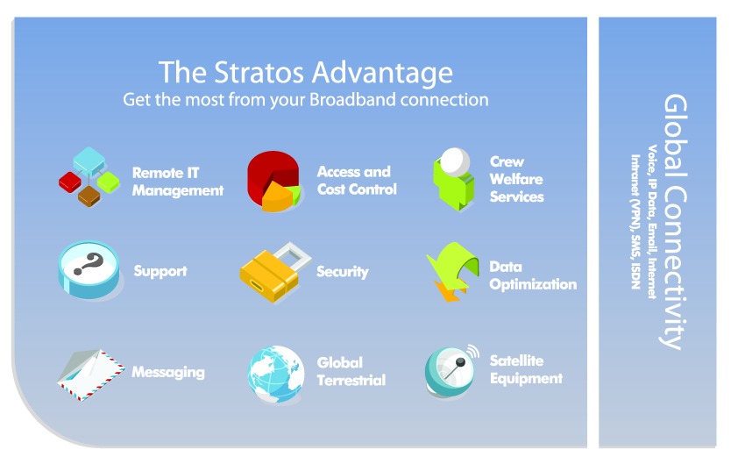

Slide 11
FleetBroadband Terminals

Slide 12
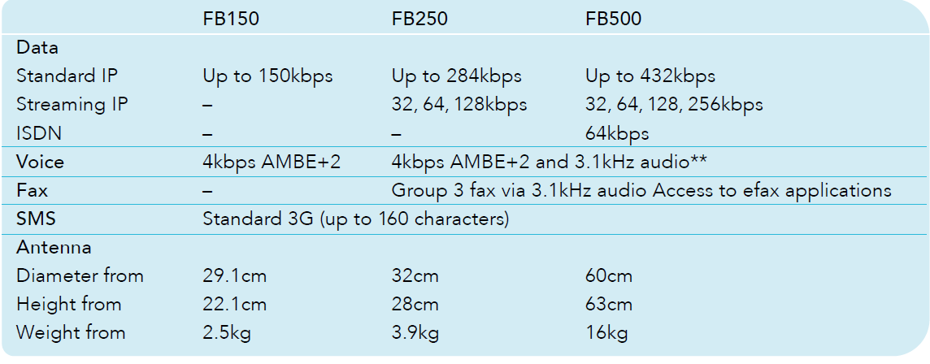
FleetBroadband Terminal Classes
Three classes of terminals
  Different performance capabilities
  Multiple manufacturers to choose from

Slide 13
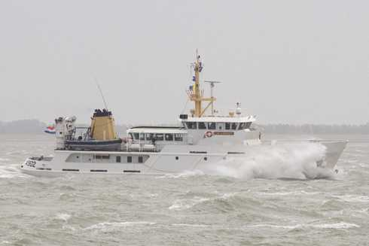
FleetBroadband Pricing:
Package supporting a broad range of customer needs

Slide 14

FleetBroadband Packages
Five types of FBB Pricing Packages available:
  Standard Plan - pay as you go
  Starter Plans – 25MB or 50MB/month
  Allowance bundles: up to 1GB/month
  Shared Corporate Allowance Packages (SCAPs): up to 5GB/month
  Hardware bundles – avoid up front capital investment

Slide 15
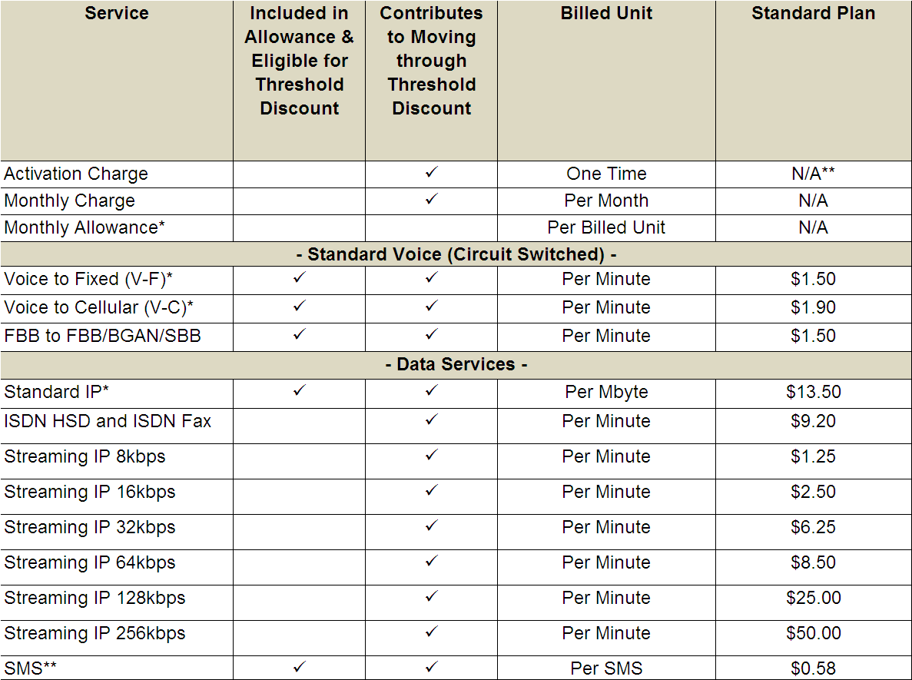
FleetBroadband Packages: Standard
FBB Standard Plan
No subscription charges
No minimum contract duration
  = current E&E pricing model (pay as you go).
Only pay for what you use

Slide 16
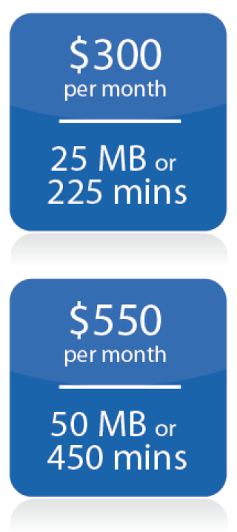
FleetBroadband Packages: Starter Plans
FBB Starter Plans:
Subscription charge
Money bundle – use voice or background IP
Minimum three month contract
25MB -50MB meets the current data usage of the majority of vessels today.

Slide 17
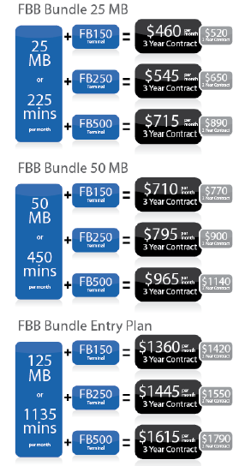
FleetBroadband Package Options:
Hardware bundles
Hardware bundles
Allows Stratos and our partners to offer vessels an upgrade option with No Capital Investment – One Low Monthly Rate
Own the FleetBroadband Terminal of Choice After the Contract Period
2 year and 3 year options

Slide 18

New: Value Bundles
Lower priced bundles by selecting AddValue FB150 or Satlink FB250
Continued access to multiple airtime package sizes
Benefit to the customer:
Further reduce your communications investment!

Slide 19
Cost Savings With FleetBroadband
FleetBroadband allows the vessel to cut operational costs
  Fuel
  Crew retention
  Maintenance
Can also cut communications costs
  A real-life example follows
< 1% of costs spent on communications

Slide 20
Evaluation of FleetBroadband by Bernard Schulte Group
Previous performance …*
An average monthly cost of $1,500 (approx) using an Inm-B (e-mail only)
based on 26 MB Data and 200 voice minutes
Current performance using a FleetBroadband terminal
monthly cost amounting to $800 using a FB
transmitting 50 MB Data and 200 voice minutes
* Source: Stratos Channel Partner “One Net” (Cyprus)

Slide 21
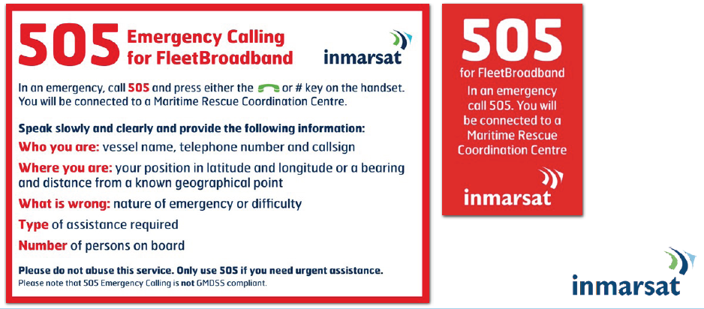
Inmarsat Safety Services

Slide 22
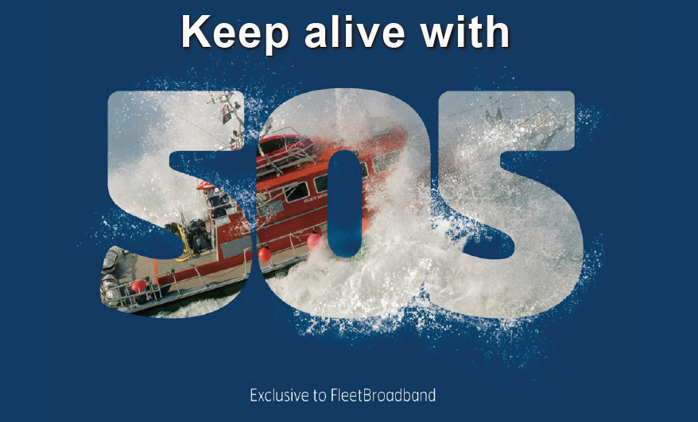

Slide 23

Volvo Ocean Race

Slide 24
The Stratos Advantage™
StratosNexus™
End-to-End Secure
FleetBroadband Backbone Infrastructure

Slide 25














The StratosNexus™ Network for I-4 Services
Customer Network Americas
Customer Network AsiaPac
3
StratosNexus
ATM or MPLS
Customer Network Europe
I-4 Satellite
1
Stratos Dashboard
Stratos Trench
2
Customer Network
Inmarsat
SAS
Stratos PoP
Internet
A Range of Interconnect Options
4
1
Standard Internet
2
BusinessAccess - IPSec VPN to Customer Site
3
BusinessAccess or GuaranteedAccess - Private Line
Direct from Stratos PoP via StratosNexus
Customer Network
4
GuaranteedAccess - ISDN On Demand Dialling (IP Delivered via ISDN)
ISDN
Dial On Demand

Slide 26
Stratos IP Access Types
IP Communication
Data Communication between FleetBroadband (FBB) terminals and the Internet or a corporate network runs over the IP protocol.
To enable this communication, the terminal requires access to the network with an IP address. An IP address can be seen as a telephone number for data communication.
Stratos provides customers with a range of flexible IP address and access type solutions.
These include public, private, dynamic and static IP addresses as well as various end-to-end streaming and private network solutions.

Slide 27
The Stratos Advantage™
Stratos Dashboard™
On-line FleetBroadband Service Management

Slide 28
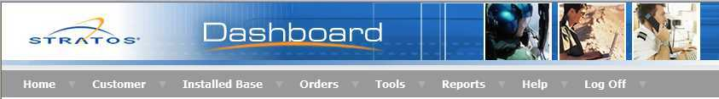
An Introduction to Stratos Dashboard™
Supports FleetBroadband, SwiftBroadband, BGAN and Satellite Phone Services
Quick and easy on-line provisioning
Cost control and credit management
Up-to-date invoices and contracts
Near real-time traffic management
Extensive downloadable report options
Different access level to suit all needs
Integrated Stratos Trench Firewall Rule Sets
Stratos Dashboard is fully automated and directly linked
to the Inmarsat Business Support System

Slide 29
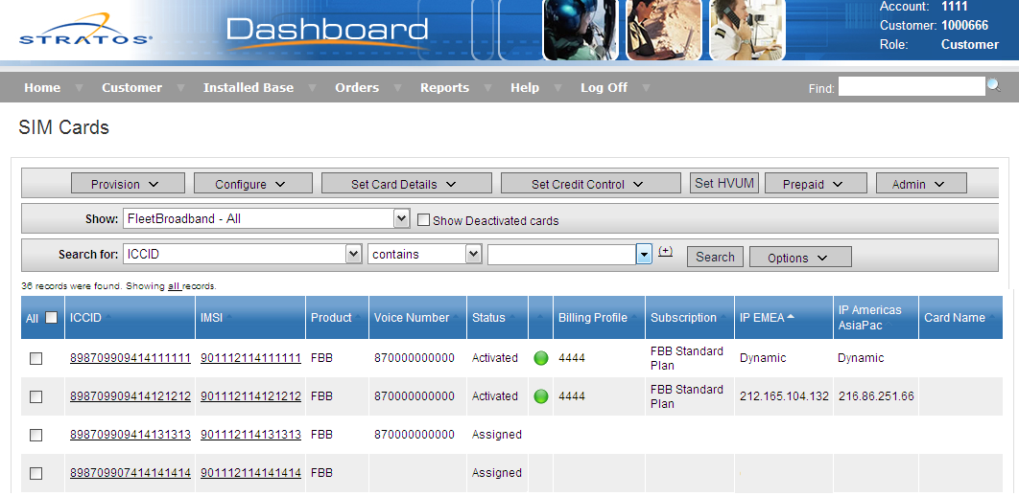
Comprehensive Overview of Your Installed Base
Status of all your FleetBroadband SIM cards

Slide 30
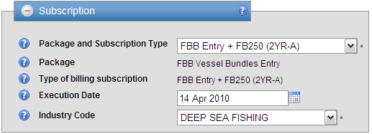
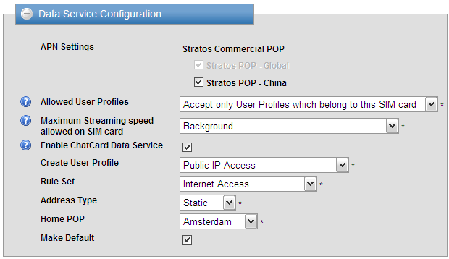
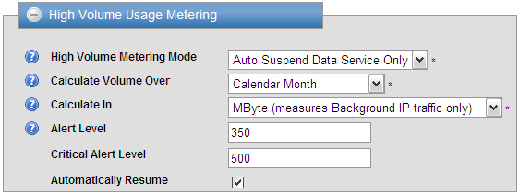
Activate and Configure SIM Cards
Activate your SIM cards in just minutes
Create default settings to speed up activations and minimize activation errors
Select required Data and IP address settings
Set credit limits and alerts to protect against surprises

Slide 31
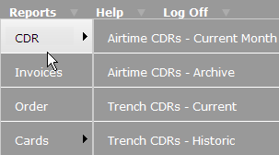
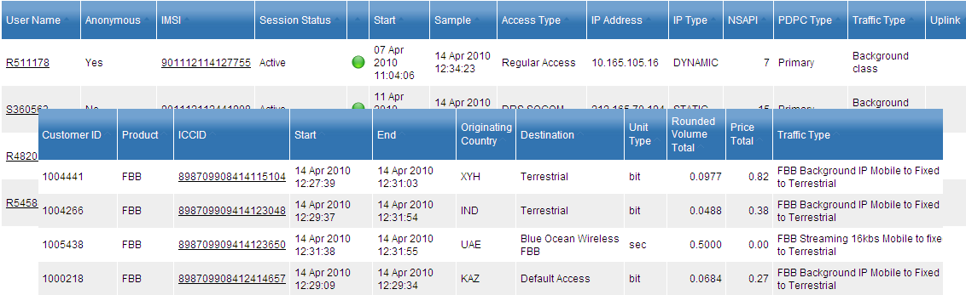
Real Time Traffic Information
A near real-time overview of all traffic usage, rated against the invoice price
Includes calls that are currently in progress in addition to finalized calls.
Four CDR options to select from:
  Airtime CDRs:
    Current Month and Archive
  Trench Data CDRs
    Current (open sessions) and Historic (closed sessions)

Slide 32
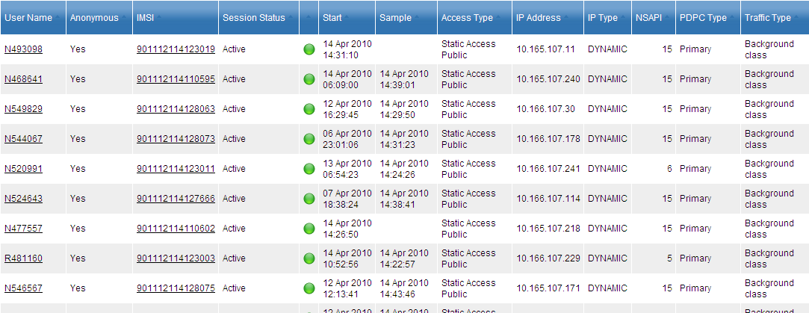
Trench Call Data Report (CDR): Current Terminal Status
Identify SIM cards that are currently active and running data traffic

Slide 33
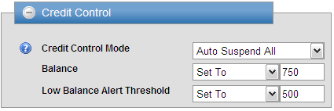
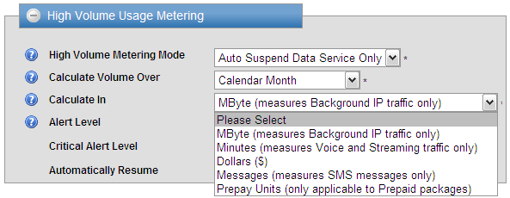

Prevent Surprise Invoices: Credit Control
Stratos Dashboard offers different options to monitor traffic usage:
Credit Control:
  Credit Control on individual SIM cards, groups of SIM cards, SCAPs
High Volume Usage Metering
  On MB, Minute, Dollar,
  SMS, Prepay units
Receive email alerts on multiple email addresses

Slide 34
The Stratos Advantage™
Stratos Trench™
Firewall Protection Against Internet Threats

Slide 35

Protection Against Internet Threats
Stratos Trench is a firewall that sits between the satellite network and the Internet
It allows terminals to access the Internet while at the same time ensuring that incoming malicious traffic is blocked
Since Internet traffic is blocked before it goes over the satellite path you will not be charged for it
Charges are levied only for IP traffic that passes over the satellite link in both directions
Using only the firewall on your computer blocks traffic only after it has already come over the satellite path and hit your invoice, therefore Stratos Trench brings you additional cost savings

Slide 36
Setting Stratos Trench Firewall Rules
Stratos Trench allows you to configure the firewall rules for your specific needs
    Example: A corporate administrator can implement firewall rules across all employees, while at the same time preventing employees from modifying these rules
Three ways to specify firewall rules:
Public Rule Sets – created by Stratos and can be applied to all SIM cards, for example allowing Internet access or e-mail only.
Private Rule Sets – created by the customer for complete control over the IP Address, Protocol, Port and Subnet values; can be set on all User Profiles that belong to the same customer and any SIM card
Custom Rules – individual rules created by the customer that apply only to one User Profile

Slide 37
Available Public Rule Sets
Internet Access | All IP protocols are allowed for data traffic from the mobile to the internet All IP protocols are not permitted for data traffic from the internet to the mobile This rule ensures that any type of data traffic from the terminal is allowed, but unwanted data traffic to the terminal is blocked.
Open | All IP protocols are allowed for data traffic from the mobile to the internet All IP protocols are allowed for data traffic from the internet to the mobile Suitable if the SIM card needs to be reached from the Internet, e.g. in case the SIM card has Transparent Access with a static IP address on it.
Email Only | All IP protocols for email (SMTP, POP, IMAP and Secure SMTP) are permitted for data traffic from the mobile to the internet All other IP protocols are not permitted for data traffic from the mobile to the internet All IP protocols are not permitted for data traffic from the internet to the mobile The effect of this rule is that the data connection can only be used to send and receive email, and not for, for example, internet browsing
Closed | All IP protocols are not permitted for data traffic from the mobile to the internet All IP protocols are not permitted for data traffic from the internet to the mobile With this rule set no data traffic is allowed at all. The SIM card can only do voice and SMS
AmosConnect Only | All IP protocols are permitted for data traffic from the mobile to the Stratos AmosConnect server All other IP protocols are not permitted for data traffic either to or from the mobile If this Rule Set is selected, all traffic is blocked except for AmosConnect.
StratosNet Accelerator | All IP protocols are permitted for data traffic from the mobile to the StratosNet Accelerator application, both Client and Clientless Stratos All other IP protocols are not permitted for data traffic either to or from the mobile If this Rule Set is selected, all traffic is blocked except for StratosNet Accelerator.

Slide 38
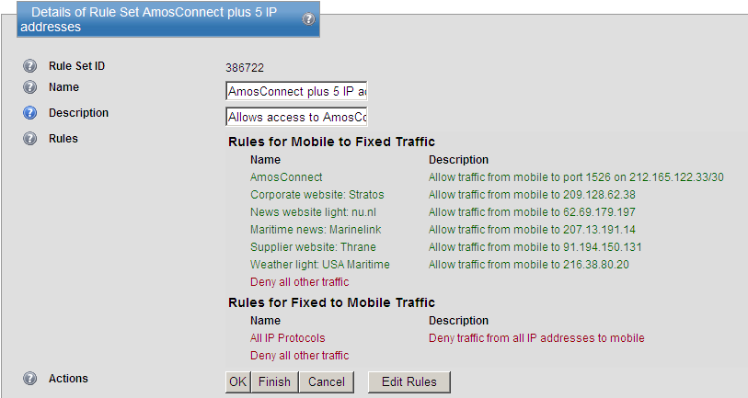
Sample Custom Rule Set
User Profile based on Private IP Access, no streaming
Custom made Trench Rule Set

Slide 39

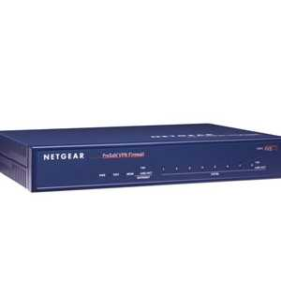
Security Solutions
  Firewall - Restrict traffic by destination, source, and protocol
    Shore side: The Stratos Trench
    Vessel Side: Physical (Netgear)
    Necessary for cost control and security
Protect all onboard network PCs
Small updates
  Typically between 1KB and 40KB
Stratos channel partners also provide their own anti-virus services to vessels at sea.

Slide 40
The Stratos Advantage™
Services to Optimize Your User Experience
Specialized Services for Satellite Communications

Slide 41




Stratos MobileLink™ - Fixed-to-Mobile Calling
Reduce long-distance calling costs by up to 60%
Three options with voice prompts to guide the way:
Stratos MobileLink Easy
  Dial a pre-defined terrestrial number (USA or Dutch) to connect directly to the satellite terminal
Stratos MobileLink Secure
  Dial the Stratos MobileLink Secure number
  Enter an Access Code per satellite terminal for additional security
Stratos MobileLink Flex
  Dial the Stratos MobileLink Flex number
  Enter an Access Code followed by an optional PIN Code per terminal
  Dial the Mobile number (satellite terminal)
Ideal alternative if your local telephone company does not allow calls to Inmarsat or Iridium phones or is charging too much money

Slide 42
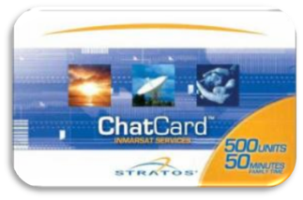
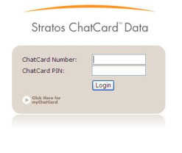
Stratos ChatCard™ - Prepaid Services
One prepaid calling card used for All-in-One Crew Comms
  Pre-paid voice, email, SMS, Internet
Enhanced Super Quiet Time, exclusive to FleetBroadband, offers one low calling rate 24/7, 365 days a year
Web Browsing via ChatCard Data, optimized with StratosNet Accelerator
  Start the browser, login with your Stratos ChatCard number and access the Internet
The Stratos Advantage™: Online Management
  ChatCard Online: manage your ChatCards
  MyChatCard: put the power of purchasing and reloading into the hands of end users
Ensuring crew has access to call friends and family improves morale, productivity, and retention rates.

Slide 43
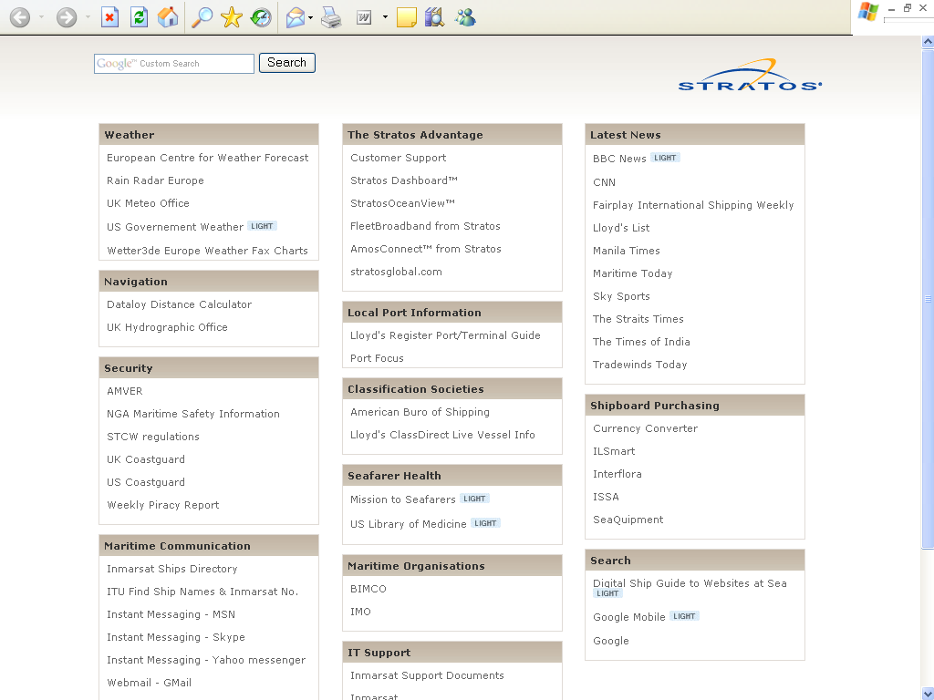
www.stratosglobal.com/start/maritime

Slide 44
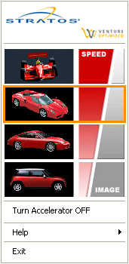
StratosNet® Accelerator – Data Compression
Compresses everything that passes over the IP satellite link and optimizes transport protocols for faster, more efficient throughput
Client-server based application
Select your desired compression level
Disable or enable the application at any time
Easy to use - no registration, no fees, no username or password
Reduce Standard IP access costs by up to 90%
An ideal complement to Stratos ChatCard Data for Internet use
Level 3 compression

Slide 45
StratosNet Accelerator - Actual Savings
Application | Type | Average Compression
Web Browsing | Level 1 | 70%
 | Level 2 | 78%
 | Level 3 | 83%
 | Level 4 | 85%
FTP | Excel File | 80%
 | Text File | 98%
Email | Excel File | 86%
 | Text File | 99%

Slide 46
AmosConnect 8
Communications beyond messaging!
In service since 2001
Over 20,000 licenses issued
Approximately 240,000,000 messages sent to date
Some more details:
Full mail server and web server
Bandwidth control through
  Automatic compression of emails
  Efficient Web Browsing and File Transfer
Stay tuned… more to come from Andrew

Slide 47
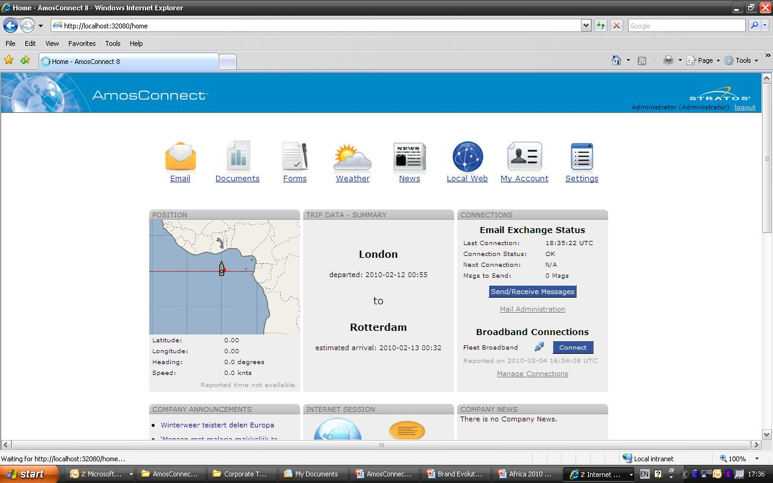

Slide 48

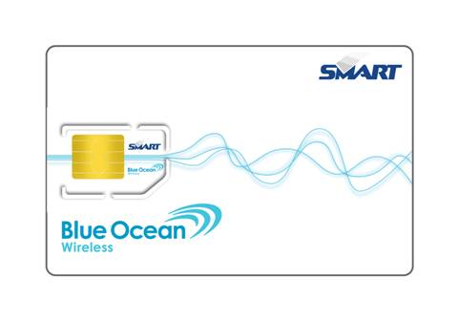
BOW GSM Service via FleetBroadband
Functionalities:
Making use of your GSM cell phone over FBB 8K Streaming (no interference with business voice line)
Outgoing voice calls from your mobile phone.
Send and receive text messages on your mobile phone.
Conditions:
GSM voice and SMS service coverage in dedicated (crew) areas.
Any GSM phone supporting the 1800 MHz frequency band will work
System automatically turns on and off nearby land to avoid interference with land based networks (legislation).
BOW GSM SIM CARD
Notes:
Important:
- 8K streaming; High quality and no interference with commercial circuit switched calling!
System will work in European and UAE harbours, if in line of sight
Prepaid, customer will not be charged for airtime (both streaming as background IP for SMS and signalling)

Slide 49
Consultancy and Expertise
Stratos Customer Care
  24/7 continuously trained, skilled representatives for reliable, efficient, and responsive support.
MSS Technical Services
  Shop and field technicians act as tier two support for troubleshooting of hardware.
IT Consultancy via…
Our customers and partners have access to exceptional Engineering resources
  Customer Solutions Engineers:
    Prepare application notes and project management for customized solutions.
  Sales Engineers:
    Support our customers directly or via Stratos partners with consultancy on technically advanced applications.
  Eco-Partners
    An extended suite of value-added services available to Stratos customers.
  Channel Partners

Slide 50

The Stratos Advantage™:
Summary

Slide 51
Stratos Value-Added Services improve the broadband experience
The Stratos Advantage™
  Infrastructure and last mile connectivity
  Cost and traffic control & provisioning
  Security services
  Data optimization
  Crew Communication
  Customer service and consultancy
Over 4,500 Stratos FleetBroadband customers today.
Over 10,000 Inmarsat FleetBroadband customers in total.
FleetBroadband from Stratos is the safe, reliable and fully managed communications solution for your fleet.
Stratos, with our partners is ready and able to support you with your FleetBroadband implementation.

Slide 52

Happy Mbytes!
Thank You!
For more information on value added services for FleetBroadband:
Visit us on our website www.stratosglobal.com
STRATOS CUSTOMER SERVICE:
Tel: 1 709-748-4226 Worldwide
E-mail: support@stratosglobal.com

Slide 53
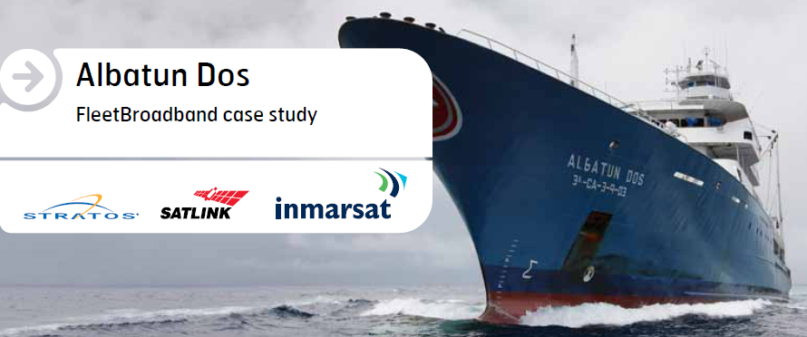
Case Study + Video FleetBroadband on Albacora Fishing Vessel
Downloadable via www.stratosglobal.com

